Slide 1
Programming Fundamentals
Lecture 11

Slide 2
Objectives
C++ Structures
Structure Declaration
Accessing the Members of a Structure
Structures and Arrays
Assignment and Relational Operators with Structure Members
Passing and Returning Structures from Function
Structures and Pointers

Slide 3
C++ Structures
C++ allows us to create our own user-defined aggregate data types
An aggregate data type is a data type that groups multiple individual variables together
C++ Structure is a collection of different data types under the same name
Structures in C++ are user-defined aggregate data types that are used to store a group of items of non-similar data types

Slide 4
Structure Declaration
We can declare the structure by using the struct keyword
The general syntax of a struct in C++ is given below
  struct struct_name
  {
    DataType1 identifier1
    DataType2 identifier2
    .
    .
    DataTypeN identifierN
  };
struct Student
{
  string name;
  string address;
  char grade;
  float cgpa;
  int ID;
};
In this example a user defined data type is defined with name “Student” which has 5 data members

Slide 5
Defining a Structure Variable
Structure is defined before the main program and the structure variable is then defined in main program
In the given example Employee is a structure with three members (name, id, salary) and e1, e2 are its variables
struct Employee
{
  string name;
  int id;
  float salary;
};
main()
{
  Employee e1, e2;
  system (“pause”);
}

Slide 6
Accessing the Members of a Structure
To access a structure member (component), you use the struct variable name together with the member name; these names are separated by a dot
The syntax for accessing a struct member is
structVariableName.memberName
Here the dot is called “member access operator” or simply the “dot operator”
struct Employee
{
  string name;
  int id;
  float salary;
};
main()
{
  Employee e1, e2;
  e1.name = “Ali”;
  e1.id = 12;
  e1.salary = 40000;
  e2.name = “Usman”;
  e2.id = 18;
  e2.salary = 50000;
  system (“pause”);
}

Slide 7
Using cin and cout With Structure Variables
If you want to take input or display the values of a structure variable then you need to apply the cin and cout to individual member of that particular structure variable
Writing
cin>>e1;
OR
cout<<e1;
Will produce a syntax error
struct Employee
{
  string name;
  int id;
  float salary;
};
main()
{
  Employee e1, e2;
  cin>>e1.name>>e1.id;
  cin>>e2.salary>>e2.id;
  cout<<e1.name<<e1.id;
  cout<<e2.salary;
  system (“pause”);
}

Slide 8
Using = with Structure Variables
Unlike arrays we can use assignment operator between two structure variables
In fact the statement
e2 = e1
is equivalent to following statements
  e2.name = e1.name;
  e2.id = e1.id;
  e2.salary = e1.salary;
struct Employee
{
  string name;
  int id;
  float salary;
};
main()
{
  Employee e1, e2;
  e1.name = “Ali”;
  e1.id = 12;
  e1.salary = 40000;
  e2 = e1;
  system (“pause”);
}

Slide 9
Comparison (Relational Operators) on Structure Variables
To compare struct variables, you compare them member-wise
As with an array, no aggregate relational operations are performed on a struct
The statement
if(e2 == e1)
Will produce a syntax error
struct Employee
{
  string name;
  int id;
  float salary;
};
main()
{
  Employee e1, e2;
  e1.name = “Ali”;
  e1.id = 12;
  e1.salary = 40000;
  e2.name = “Usman”;
  e2.id = 18;
  e2.salary = 50000;
  if(e1.id == e2.id)
  cout<<“Duplicate”;
  system (“pause”);
}

Slide 10
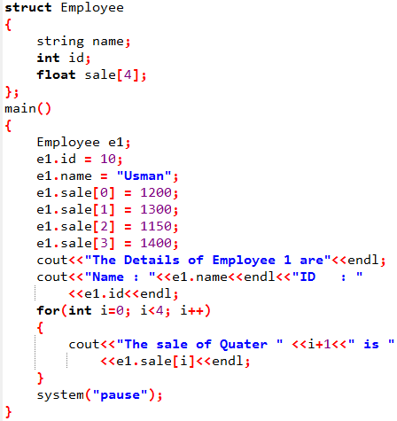
Arrays in Structures
Structures can have arrays as there members
In the given example there is an array of size 4 which will store the sale of the employee
The array members of structures are accessed in the same manner as we access the elements of the array
Have a look at the example code

Slide 11
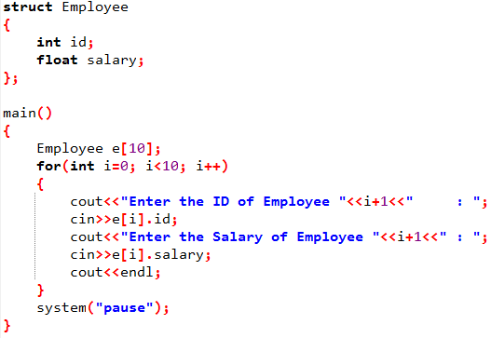
Structures in Arrays
We can also create an array of structure variables
The following code will ask the user to enter the details of 10 employees

Slide 12
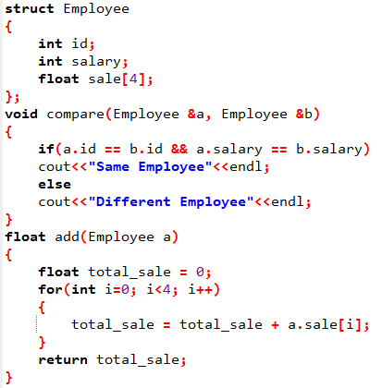
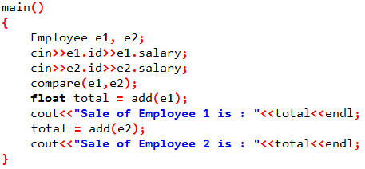
Passing Structure Variables to Function
Structure variables can be passed as arguments either by value or by reference to a function.
Have a look at the following examples

Slide 13
Practice Problem 1
Modify the code on previous slide to take the input data from user for all the data members of e1 and e2.
Then compare e1 and e2 and finally display the name, id and total sale of both employees.

Slide 14
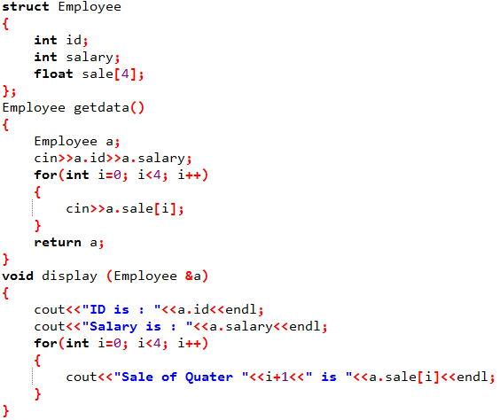
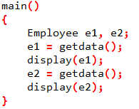
Returning Structure Variables from Functions
Structure variables can be returned from function in the same way as built-in data types
Have a look at the following example

Slide 15
Structures and Pointers
A pointer variable can be created not only for native types like (int, float, double etc.) but they can also be created for user defined types like structure
Here is how you can create pointer for structures:
(*ptr).id and ptr->id are exactly same
struct Employee
{
  int id;
  float salary;
};
main()
{
  Employee *ptr, e;
  ptr = &e;
  cin>>(*ptr).id;
  cin>>(*ptr).salary;
  cout<<ptr->id<<endl;
  cout<<ptr->salary<<endl;
  system (“pause”);
}

Slide 16
Practice Problem 2
Write a structure with the name ComplexNumbers in which there are two members (real part and imaginary part). Real part is integer and imaginary part is float.
In main program create three struct variables
Ask the user to enter the data for first two variables
Add them and store the result in 3rd variable
Then display the complex numbers and their addition
Your code must have minimum possible number of lines

